Slide 1
25FL-CS630-101HY - Database Systems
DATABASE
LIBRARY MANAGEMENT SYSTEMS
By BHARGAVI SANTHANAM

Slide 2
Database Library Management System
Goal –To create a database Library Management System with data science extensions which can accommodate the
below:
Multiple library branches data
Book catalog with availability status
Member profiles and membership data
Check-out and check-in records
Hold requests and transfer records
This section provides the complete ER Diagram (entities, relationships, cardinalities, PKs/FKs) normalized to 3NF
minimum.
It covers schema design, ERD description, normalization, DDLs and DMLs-data population methodology & reset
scripts.
Further sections will have analytical workloads, indexing strategy, and performance recommendations.
Summary:
System overview: The system manages library members, books, authors, multiple branches, hold & check-out requests, behavioral event logs, feature tables, historical snapshots, and ML recommendation outputs.
ERD Overview: The schema is normalized to 3NF. Core tables include Member, Book, Author, Staff, Book_author,
and Borrow. Analytical tables include Event_log, Feature_member, Feature_book, Daily_Snapshot, Summary_Stats &
others.
Normalization (3NF): No repeating groups • Full functional dependencies • No transitive dependencies. All these will
reduce redundancy and supports analytical workloads.
Oracle Schema Summary: All tables use Oracle NUMBER identity columns, foreign keys, check constraints, indexing, and Analytic ready structures.
We can different IDEs like SQL Developer/TOAD to develop the scripts and build the database. Here, I will be using Dbeaver IDE to connect to the oracle database and lucidchart and draw.io tool to draw the ERD.

Slide 3
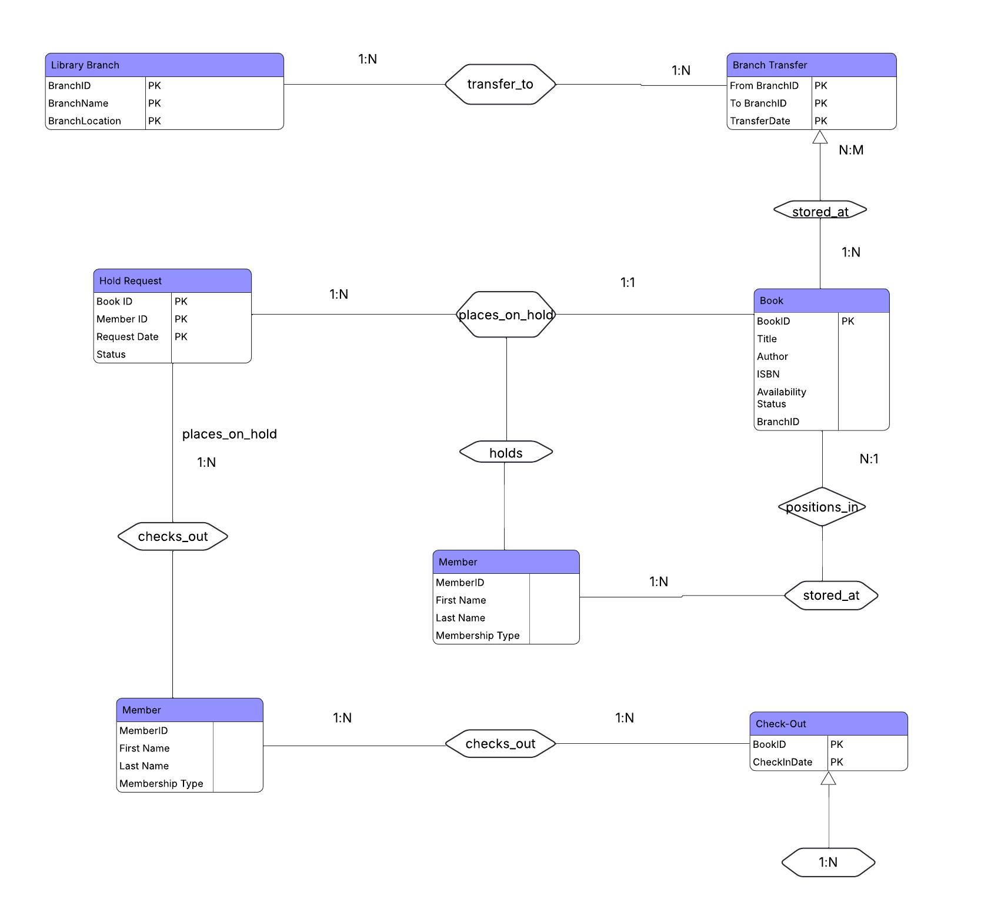
ERD –Entity Relationship Diagram

Slide 4
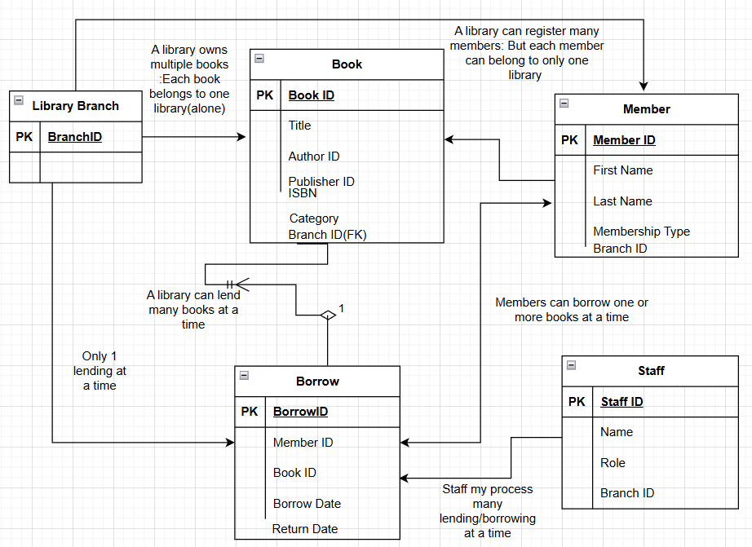
ERD –Entity Relationship Diagram-continued

Slide 5
ERD notations explanation
Library Branch (1) → (N) Book
A branch can store many books. A book belongs to exactly one branch. So, this is 1 : N.
Branch ↔ Branch Transfer (transfer_to)
Library Branch (1) → (N) Branch Transfer (both incoming and outgoing)
One branch can initiate many transfers. One branch can also receive many transfers.
Two separate 1:N relationships exist:
Branch → from BranchID and Branch → to BranchID
Member ↔ Hold Request (places_on_hold)
Member (1) → (N) Hold Request
Book (1) → (N) Hold Request
But the notation shows 1 : 1 on the Book side, meaning: A book can only have one active hold at a time in this model.
A member can place many holds, and each hold involves exactly one book.
D. Book ↔ Member (holds)
This is an implied relationship showing that a hold connects a member to a specific book.
E. Member ↔ Check-out Record (checks_out)
Member (1) → (N) Check-out Record
A member can check out many books.
Each checkout record belongs to exactly one member.
F. Book ↔ Check-out Record
Book (1) → (N) Check-out Record
A book can be checked out many times over its lifetime.

Slide 6
ERD System design overview
A library system has several branches.
Books are stored at exactly one branch.
Books can be transferred between branches.
Members can:
  Place hold requests on books.
  Check out books.
Check-outs and holds are logged for each book and member.
Each book can only have one active hold at a time (based on the 1:1 relationship in the ERD).

Slide 7
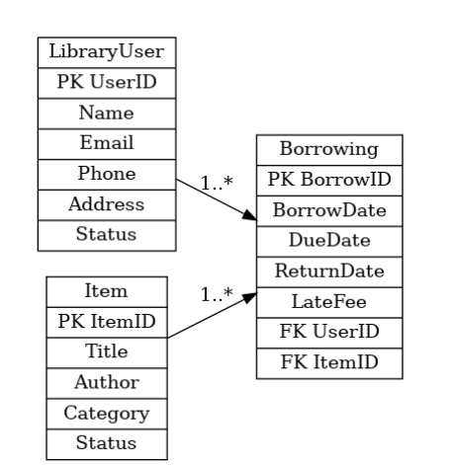
General user-borrowing diagram

Slide 8
ENTITIES
LIB_BRANCH
MEMBER
BOOK
AUTHOR
BOOK_AUTHOR
BORROW
STAFF
BRANCH_TRANSFER
CHECK_OUT
HOLD_REQ

Slide 9
Summary of ERD connections- Entities, constraints, relationships.
Entities with PKs and FKs -
  Library (Library_ID/BRANCH_ID)
  Book (Book_ID, with FKs to Library_ID, Author_ID, Publisher_ID)
  Author (Author_ID)
  Publisher (Publisher_ID)
  Member (Member_ID, FK to Library_ID)
  Borrow (Borrow_ID, with FKs to Member_ID, Book_ID, Staff_ID)
  Staff (Staff_ID, FK to Library_ID)
Cardinalities (Crow’s Foot notation):
  Library → Book: 1–M
  Library → Member: 1–M
  Library → Staff: 1–M
  Author → Book: 1–M
  Publisher → Book: 1–M
  Member → Borrow: 1–M
  Book → Borrow: 1–M (but only one active borrowing at a time)
  Staff → Borrow: 1–M

Slide 10
Relationships (Crow’s Foot Cardinalities)
Relationship | Cardinality
LibraryMember → Borrow | 1 member can have many borrowings; each borrowing belongs to 1 member (1..1 ↔ 0..*)
Book → BookCopy | 1 book can have many copies; each copy belongs to 1 book (1..1 ↔ 1..*)
Book ↔ Author | Many-to-many (resolved via BookAuthor junction table)
Borrow → BookCopy | Each loan is for 1 copy; a copy can be lent/borrows many times over time (1..1 ↔ 0..*)
Staff → Borrow | 1 staff processes many borrow; each borrow handled by 1 staff (1..1 ↔ 0..*)

